Slide 1
CITY OF OTTAWA STATE OF THE CITY MARCH 21, 2019

Slide 3
Economic PROGRESS

Slide 4
Route 71 TIF

Slide 5
Ottawa Industrial Park

Slide 6
NORTHSIDE

Slide 7
Holiday Inn Express

Slide 8
OSF Urgent Care

Slide 9
Illinois Valley Cement

Slide 10
Domino’s

Slide 11
Hawthorne Race Track

Slide 12
Ottawa Dental Lab

Slide 14
Downtown

Slide 15
Columbus Streetscape

Slide 16
New construction

Slide 17
ANTHONY PLACE

Slide 18
ANTHONY PLACE

Slide 19
112 W. Madison Street Lofts and Retail

Slide 20
112 W. Madison Street Lofts and Retail

Slide 21
205-207 W. Main Street Concept Plan

Slide 22
Carson & Woolworth building

Slide 23
Interior Elevations

Slide 24
Roof Terrace

Slide 25
Cat’s Eye Wine Bar at 724 LaSalle St.
City Folk Urban Décor at 722 LaSalle St.
Sinbad Vapors at 704 LaSalle St.
B.A.S.H at 1012 N. LaSalle St.
Prairie Fox Book Store at 719 LaSalle St.
Court Street Pub at 620 Court St.
Keke’s Sweet Shop at 216 W. Main St.
Open Space Art Gallery & Studios at 223 W. Madison St.
Lady’s & Gent’s at 721 LaSalle St.

Slide 26
Iniga Neapolitan Pizza Restaurant

Slide 28
Best Marketing Campaign & Best Social Media

Slide 29
New Festivals
Oktoberfest - Saturday, September 21, 2019
Starved Rock Country Festival of the Arts – being planned now for September, 2020

Slide 30
Façade improvement program

Slide 31
Court Street Pub

Slide 32
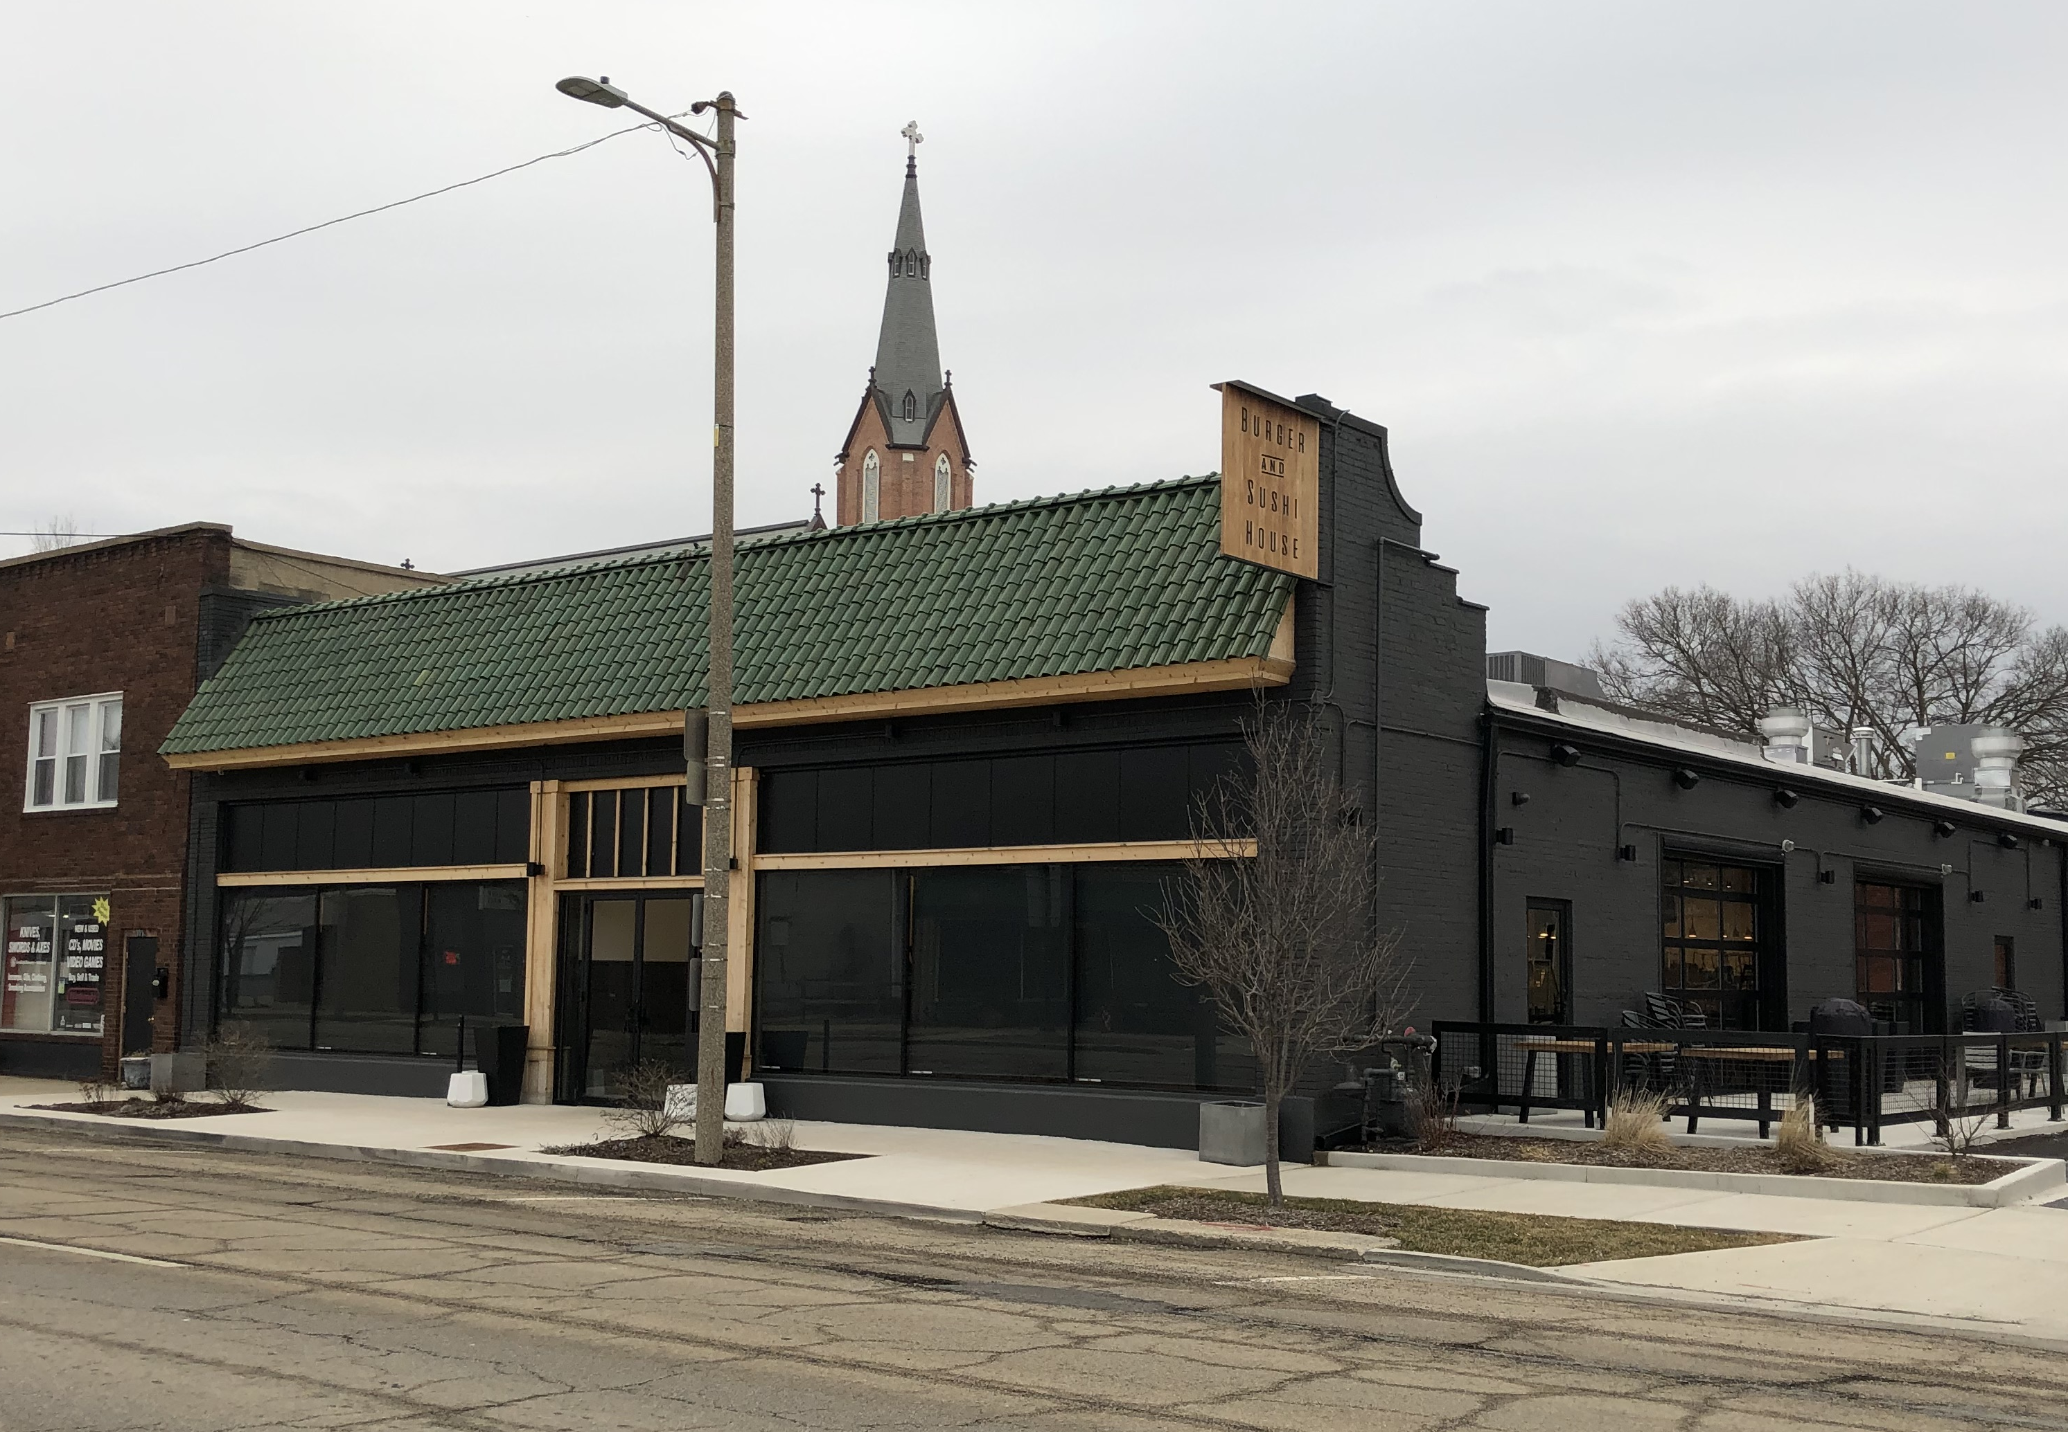
B.A.S.H.
BEFORE
AFTER

Slide 33
Riverfront development

Slide 35
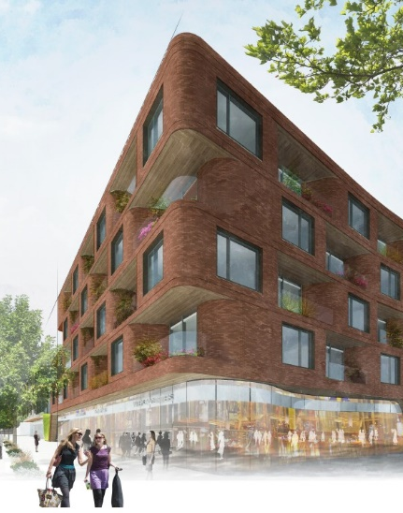
Upscale Residences and Retail
Residential Elements
Large Windows
Vertical Park
Curved Glass Retail Storefronts

Slide 36
Boutique Hotel
View from East
80+ Rooms and Suites
Upscale, Full Service
Rooftop Amenity
Restaurant and Café
Views to Park, River, and Downtown

Slide 37
Ottawa Riverfront Development
View from the East

Slide 38
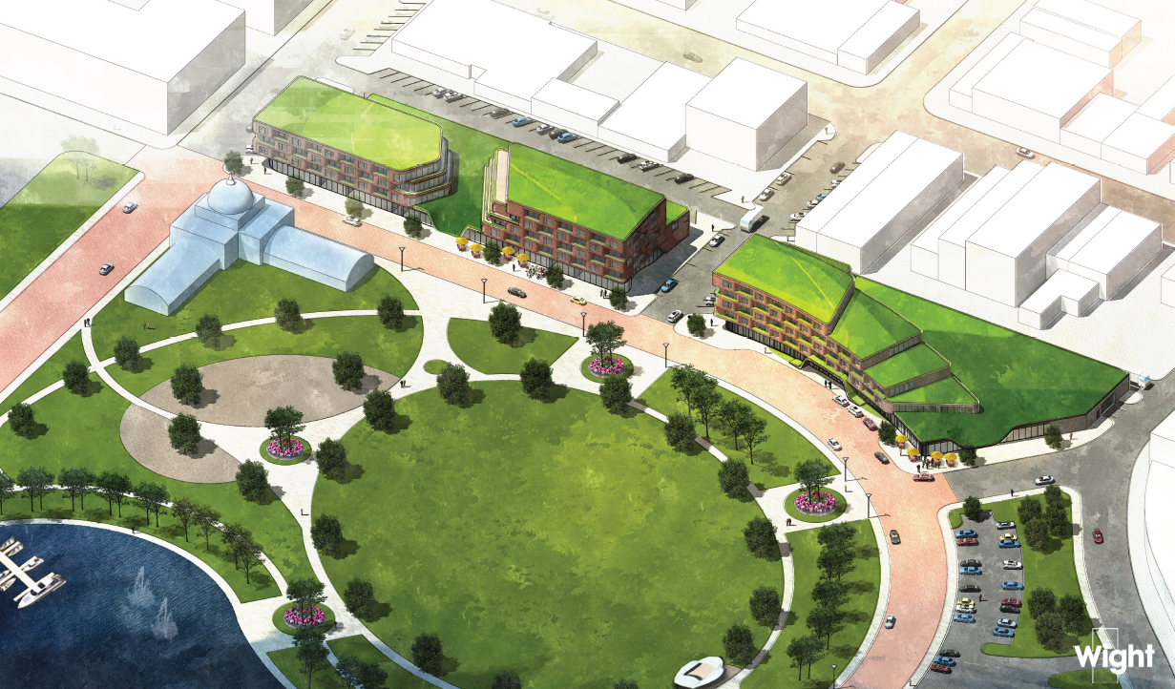
Ottawa’s New Riverfront Park
New Entrance to Riverfront
Marina
Events Lawn and Band Shell
Conservatory
Playground
Community YMCA

Slide 39
New YMCA Concept Plan

Slide 40
I&M Canal Re-Watering

Slide 41
I & M CANAL

Slide 44
REDDICK MANSION

Slide 45
American Queen & American Duchess

Slide 46
Starved Rock Country

Slide 47
Lone Buffalo Restaurant & Tangled Roots Brewery on the cover of Travel Illinois

Slide 48
Starved Rock Country

Slide 49
Starved Rock County Marathon May 11th

Slide 50
Starved Rock Community Foundation

Slide 51
American In Bloom

Slide 52
Anna Mattes Memorial Fund “Anna’s Fund”

Slide 53
City Services

Slide 54
A look back

Slide 55
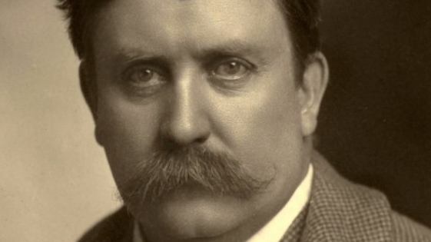
Daniel Burnham
“Make no small plans. They have no magic to stir man's blood. Make big plans, aim high in hope and work.”

Slide 56
Comprehensive Plan

Slide 57
2016 Daniel Burnham Award

Slide 58
“A canal without water is like a ham sandwich without the ham.“

Slide 59
Economic development by the numbers

Slide 60
Growth
7.6 Sq. Miles
to
15.6 Sq.Miles

Slide 61
TIF District & Enterprise Zone Map

Slide 62
Ottawa TIF Districts

Slide 63
Parks & open space a greener city

Slide 64
Parks and Open Space
110
Acres
to
438
Acres

Slide 65
Fox River Park

Slide 66
East Allen Park

Slide 67
Hollywood Park & East Main Boat Launch

Slide 68
Thornton Park Skating Rink

Slide 69
Dayton Bluffs

Slide 70
Walsh Park Dedication & Peck Park

Slide 71
Dark clouds and silver linings

Slide 72
Flooding

Slide 73
2013

Slide 74
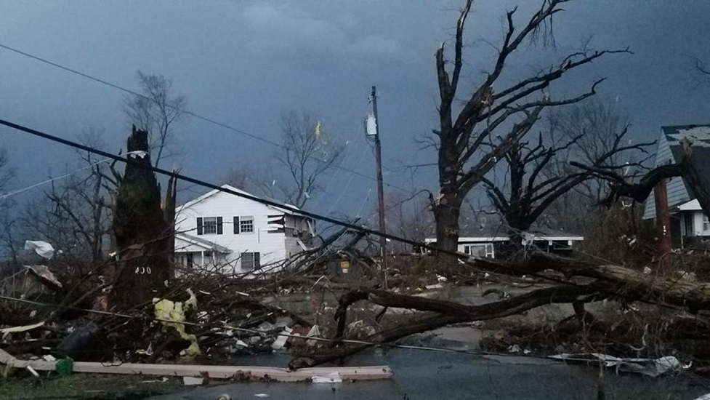

Slide 76
UAW Center -THEN

Slide 77
UAW Center – THEN

Slide 78
UAW Pat Greathouse Education Center – TODAY

Slide 79
CENTRAL intermediate SCHOOL

Slide 80
Old Central School Flooding

Slide 81
Old Central School Flooding

Slide 82
Partnerships

Slide 83
Central Intermediate School

Slide 84
ivcc Ottawa campus

Slide 85
IVCC Ottawa Center

Slide 86
IVCC Ottawa Center
Before
After
Front

Slide 87
IVCC Ottawa Center

Slide 88
Finding the money

Slide 89
“WISH LIST”
Expand Allen Park - create toboggan run
Historic street lights on LaSalle Street
Sidewalks to Shepherd School
Landscape Route 23 S-Curve
Feasibility study for the canal re-watering

Slide 90
GRANTS
Disaster & Mitigation $19 M
Parks, Trees & Downtown Streetscape $2.6 M
Streets, Walks & I-80 Pedestrian Bridge $2.9 M
Business Attraction $7.1 M
Brownfield/CERT cleanup $2.2 M
Abandoned, Blighted Property $335,000
Energy Efficiency $405,000
Planning & Studies $401,000
iFiber $17 M

Slide 91
Wind Farms

Slide 92
Radium Cleanups

Slide 93
ifiber

Slide 95
Becoming a destination

Slide 96
Branding & Marketing Plan

Slide 97
BEFORE
AFTER

Slide 98
Restaurants

Slide 99
Downtown Before & After

Slide 100
Downtown Street Lights– Before & After

Slide 101
BEFORE
AFTER

Slide 102
AFTER
BEFORE

Slide 103
BEFORE
AFTER

Slide 104
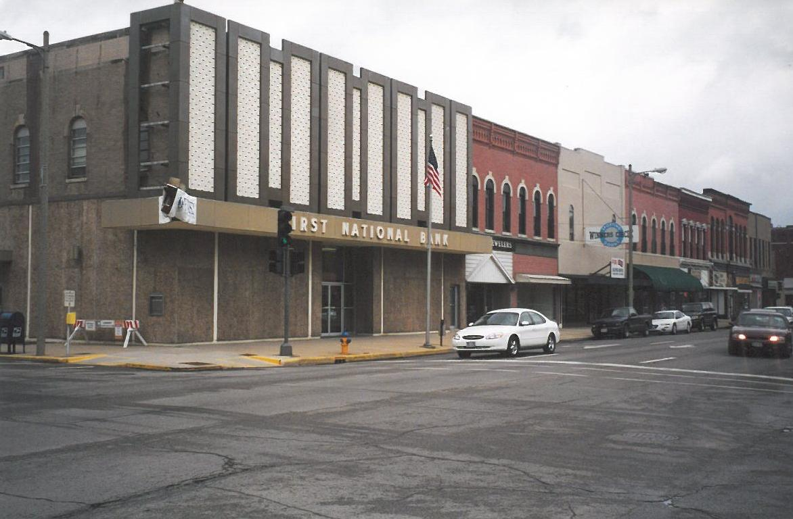
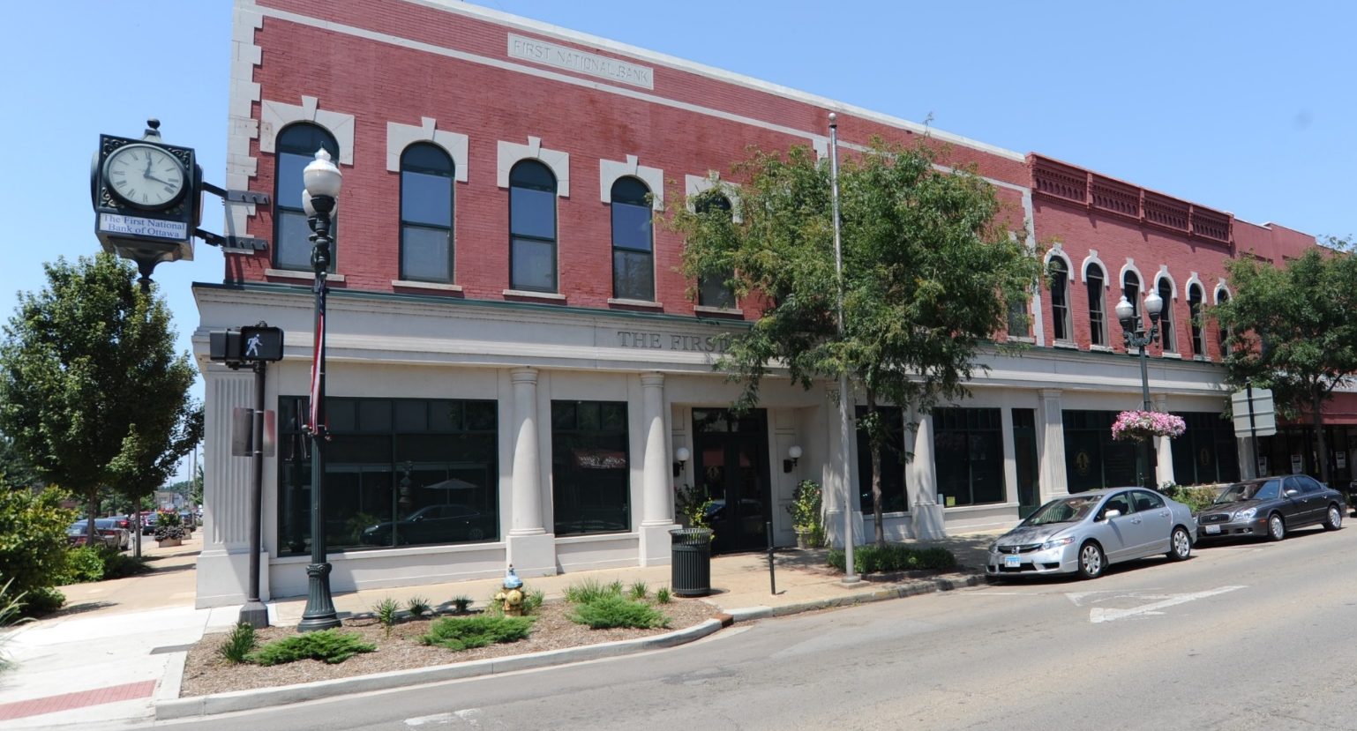
BEFORE
AFTER

Slide 105
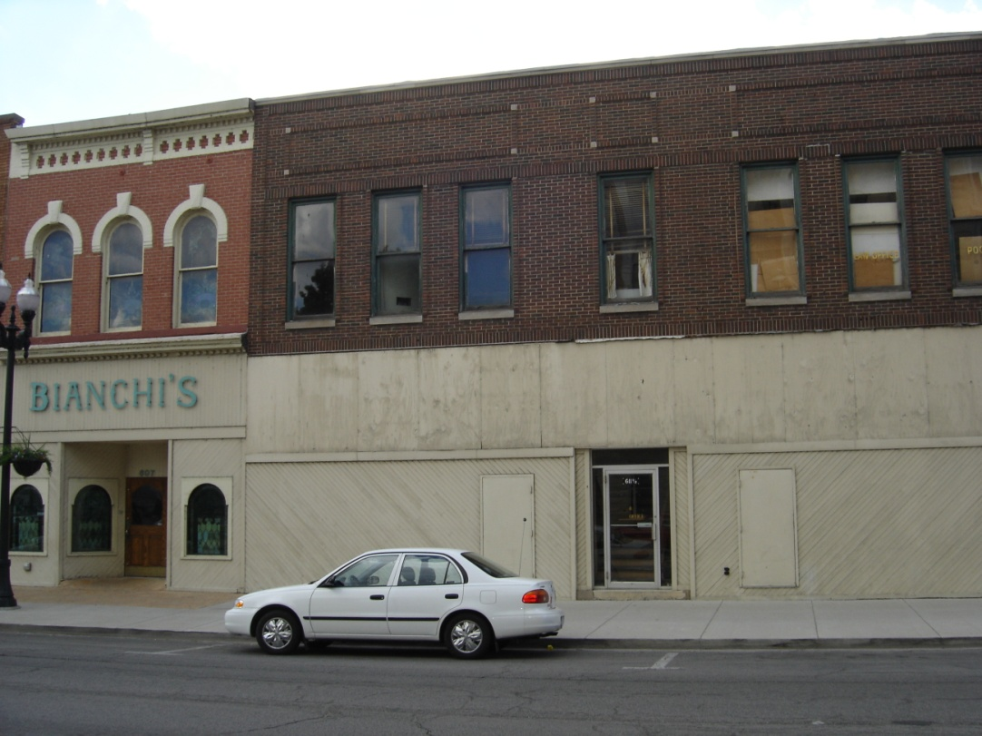
BEFORE
AFTER

Slide 106
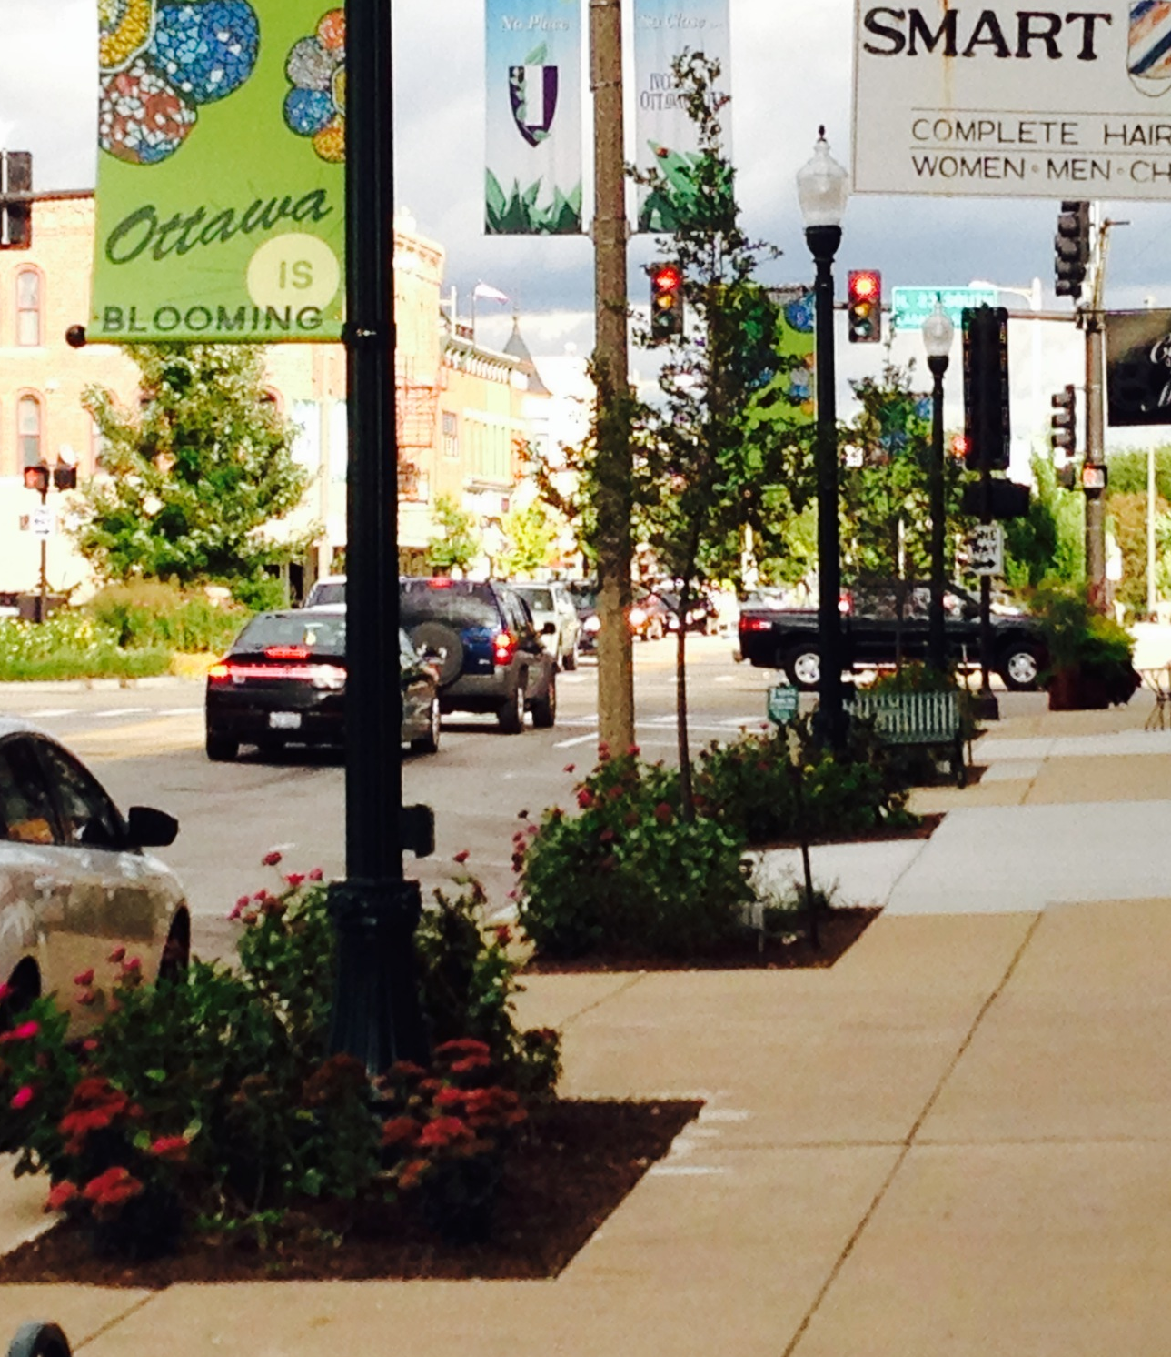
BEFORE
AFTER

Slide 107
Overnight Stays

Slide 109
Harbor Under Construction
2007

Slide 110
Heritage Harbor

Slide 111
The Lone Buffalo

Slide 112
The Lone Buffalo

Slide 113
Fema recognition

Slide 114
Mike Sutfin FEMA’S Award for Excellence & Floodplain Manager of the Year

Slide 115
CLASS 2 CRS Community

Slide 116
Thank you!

